Slide 1

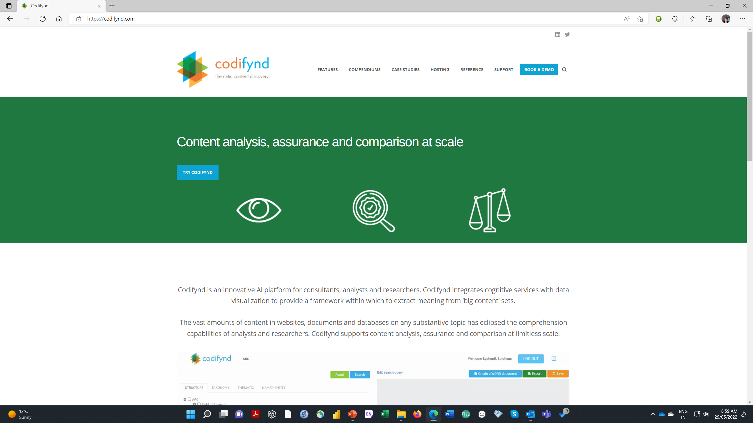
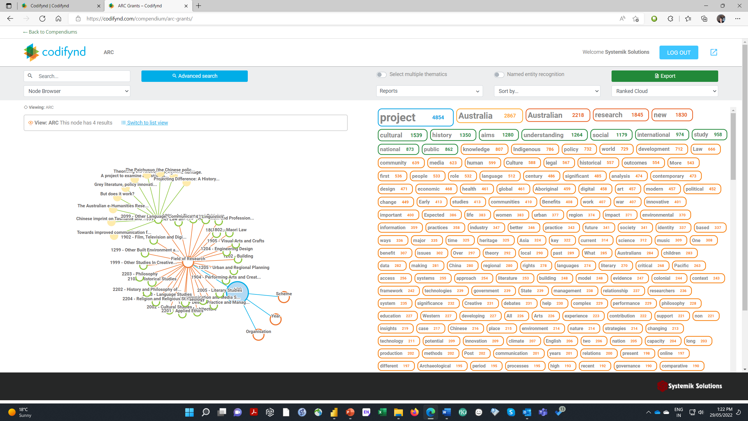
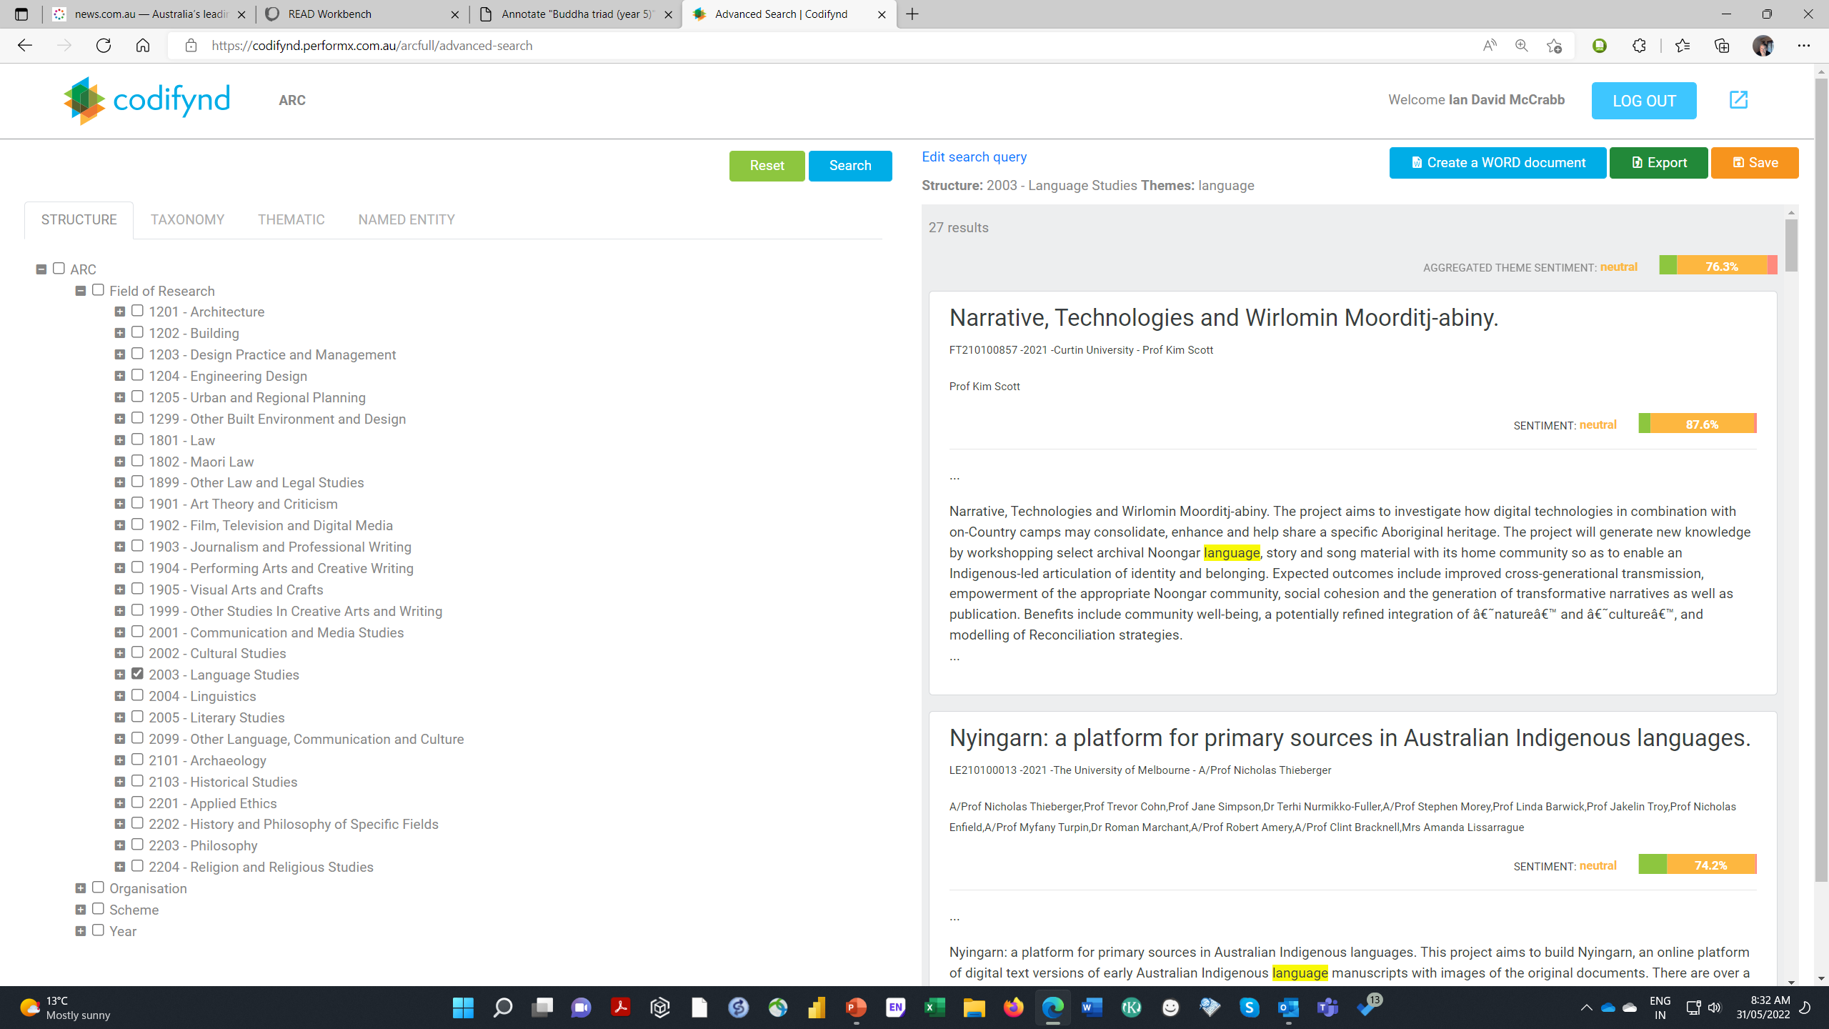
AI Thematics Workbench
Content analysis, assurance and comparison at scale
Project Goal:
The vast amounts of content in websites, documents and databases on any substantive topic has eclipsed the comprehension capabilities of researchers. Codifynd supports content analysis, assurance and comparison at scale. Codifynd integrates AI cognitive services with data visualization to provide a framework within which to extract meaning from ‘big content’ sets. Researchers can ask ‘who said what, where, in what context, and with what relationships’ without any coding and export/visualize the results.
Codifynd structures large content sets into branching nodes and uses AI cognitive services to extract noun phrases, named entities and sentiment. It provides an interactive researcher console with a suite of advanced search, natural language enquiry and network visualization features to expose, evaluate and compare themes, their intersections and patterns. The project goal is to provide a generic infrastructure relevant to, and integrated with, HASS RDC program initiatives.
Approach:
The proposed project is to: open source the existing Codifynd code base, integrate platform access with the common HASS identity model, develop automated on-boarding pathways for ATAP or Trove and develop an API for access via Jupyter notebooks. Subsequent development might include specialised on boarding pathways for ATAP or Trove, Social Sciences and Indigenous initiatives.
Benefit/Impact:
This initiative can deliver an immediate and tangible benefit by providing HASS researchers with AI cognitive services capability without the requirement to engage data scientists or developers to support their projects. Research questions that entail the exposure, analysis and comparison of themes across large heterogenous content sets can be undertaken with zero infrastructure and development cost. Researchers can experiment and rapidly iterate with sophisticated thematic enquiries across huge content sets and generate referenced results with zero technical skill.
Deliverables:
The deliverable from the project will be an open source AI Thematic Workbench platform running on ARDC server infrastructure with pilot compendiums of content from ATAP or Trove, method and process documentation, and skills transfer to ARDC.
Budget and Schedule:
Given the advanced state of development of the Codifynd platform and supporting methodology and implementation collateral the total project cost (dependent upon integration requirements) is in a range from. The project can be delivered within 4-5 months elapsed time. Systemik can provide:
research use cases,
demonstration of pilot implementation,
project proposal inclusive of requirements specification, development and implementation,
sustainability strategy for cost recovery of maintenance and support through research consulting services and platform enhancement through project specific developments.
Infrastructure Outcomes:
AI Thematics Workbench is based on a mainstream open-source technology stack, a ‘research platform mapping’ methodology, and a workflow implementation pattern proven on a suite of research and commercial platforms (READ Workbench, Intelligent Archive, PerformX and Codifynd) developed by Systemik.
Copyright Systemik Solutions 2022

